Slide 1
RAPID for CODEX Image Processing
Guolan Lu
5/26/2021

Slide 2
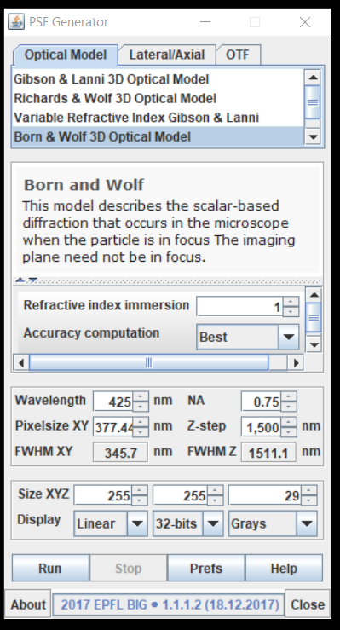
Generate PSF for four filter channels
Use imageJ plugin PSF generator to generate 4 PSF for each filter:
http://bigwww.epfl.ch/algorithms/psfgenerator/
Parameters:
Keyence microscope:
20x objective, NA 0.75, Working distance = 350 um
XY resolution(pixel size) = 377.442 nm; Z-step = 1500 nm
Wavelength (nm): input emission wavelength
DAPI: 425; GFP: 525; Cy3: 595; Cy5: 670
Image size/tile: 1920 x 1440
Number of z planes
Display: grays
Save the PSF as the following names:
PSF_BW_DAPI.tif
PSF_BW_GFP.tif
PSF_BW_Cy3.tif
PSF_BW_Cy5.tif

